Slide 1
Project Statement
Yiming Chen
yimingchen@mines.edu
Last Update: January 2023

Slide 2
Project Outline
Metasurface Array for Near-Field Focusing
Optimized phase distribution
Performance Evaluation: Focusing Gains
Machine-Learning based Antenna Design
Real Time Prediction for S11 in specific frequency range
Data-Informed Neural Networks: FNO
Different materials:
thickness
relative permittivity

Slide 3
Current Project 1

Slide 4
Metasurface Array for Different Scenarios
Only Feeding Horn
Feed Horn with FF Array
Feed Horn with NF Array
Observation Plane

Slide 5
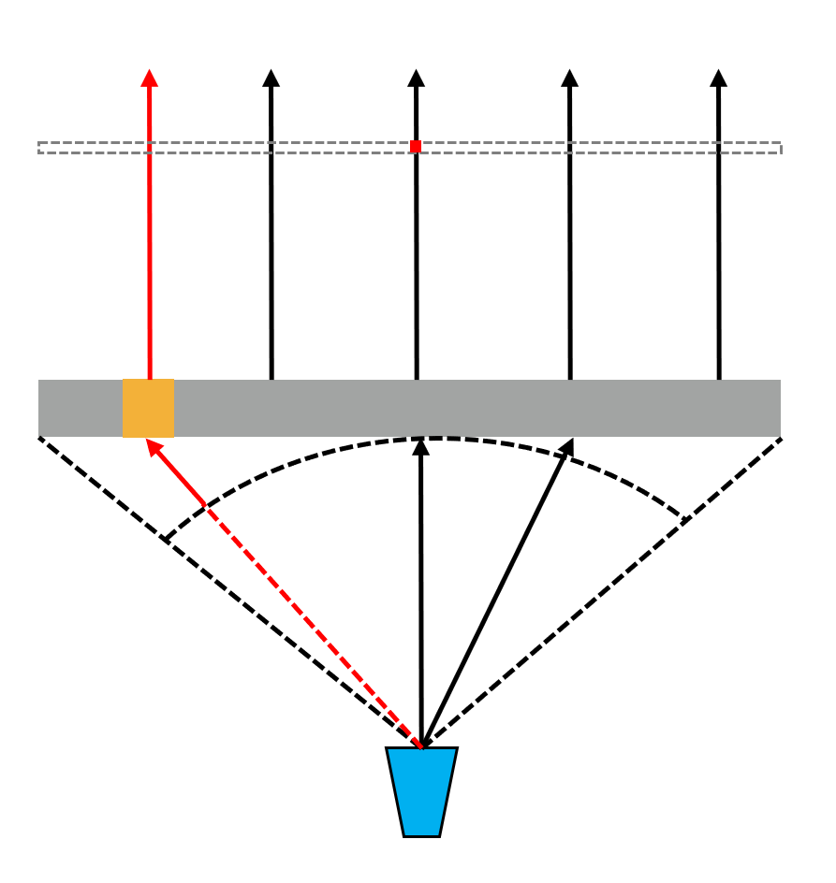
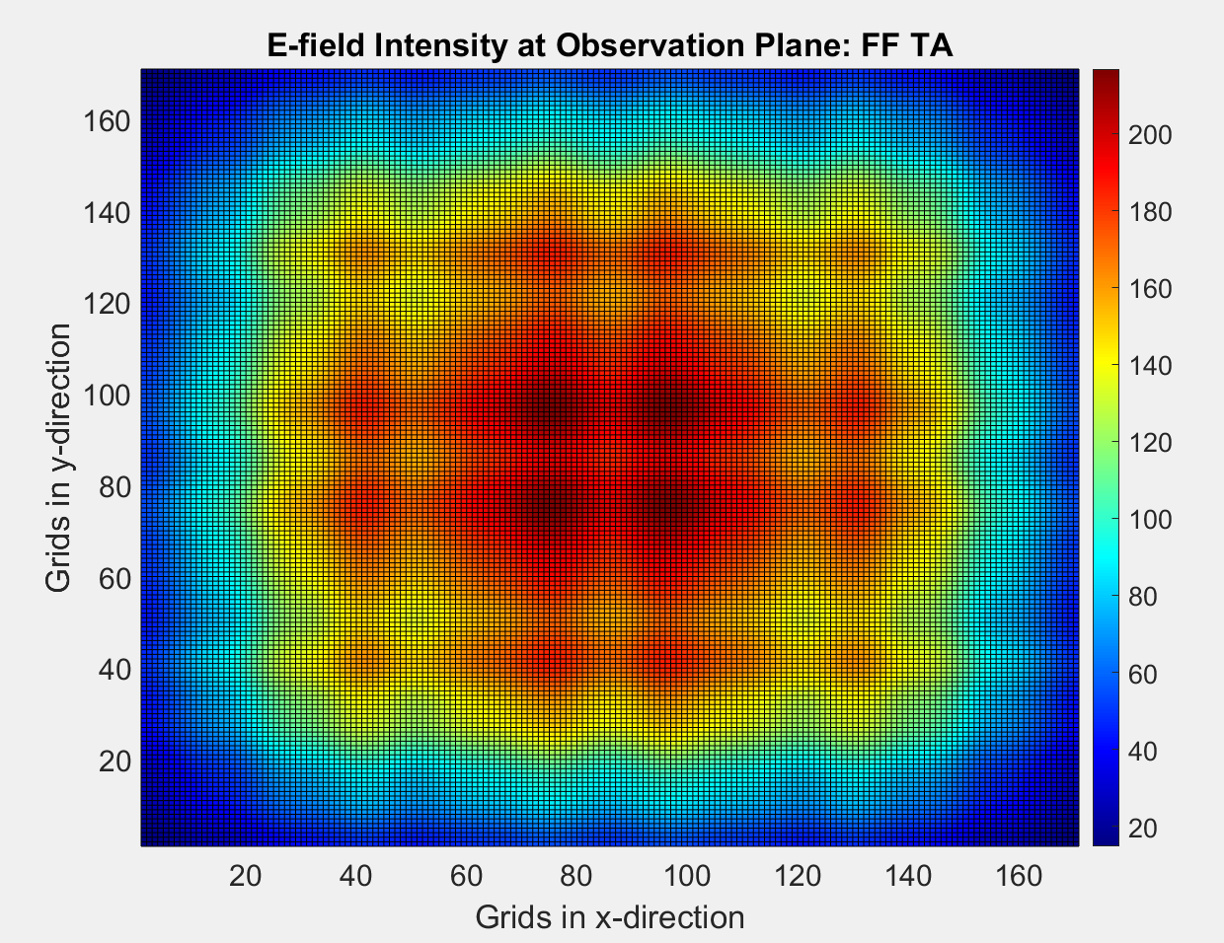
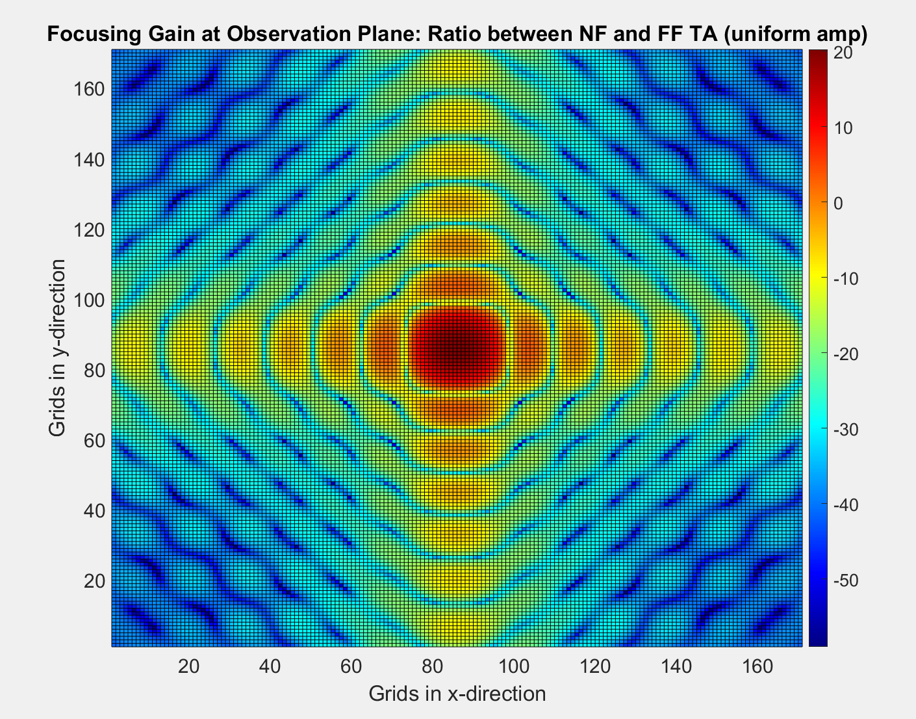
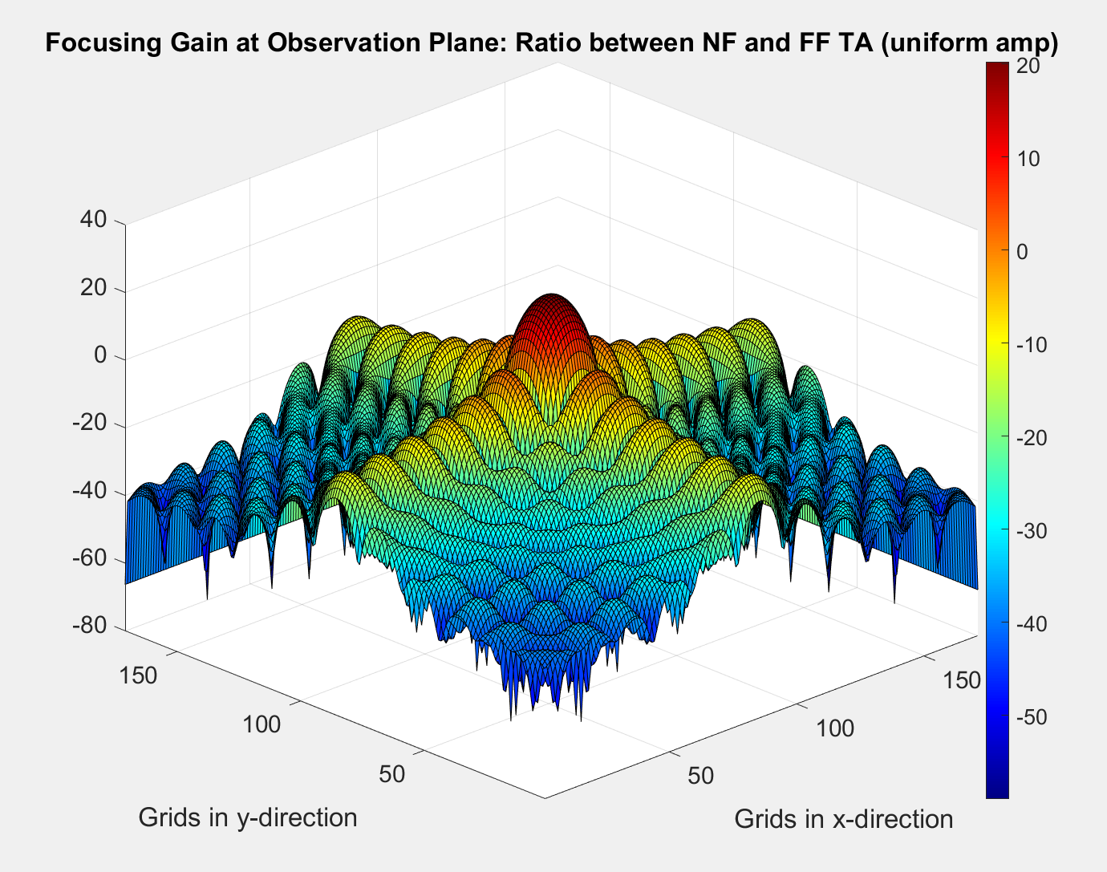
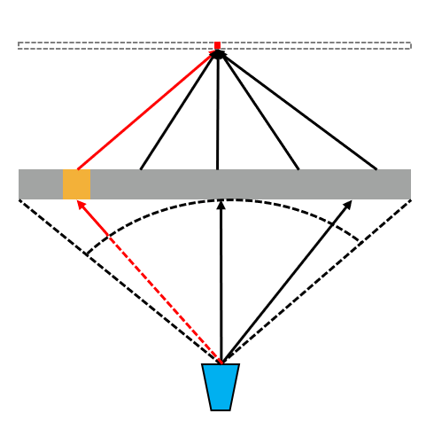
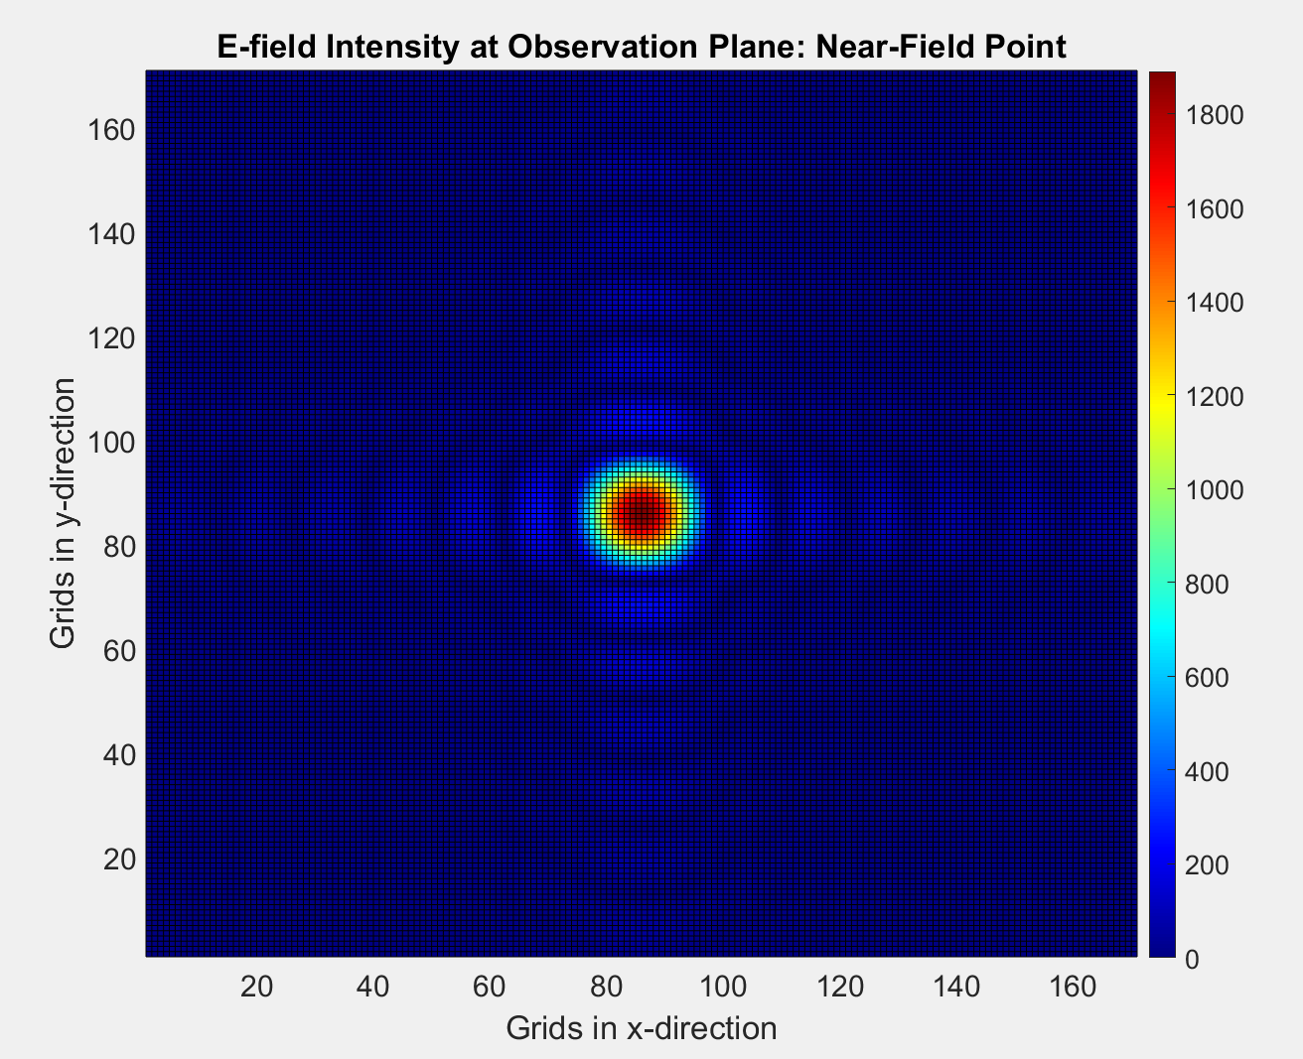
Focusing Gain between FF TA and NF TA
Displacement
E-field Distribution
Focusing Gain

Slide 6
Current Project 2

Slide 7
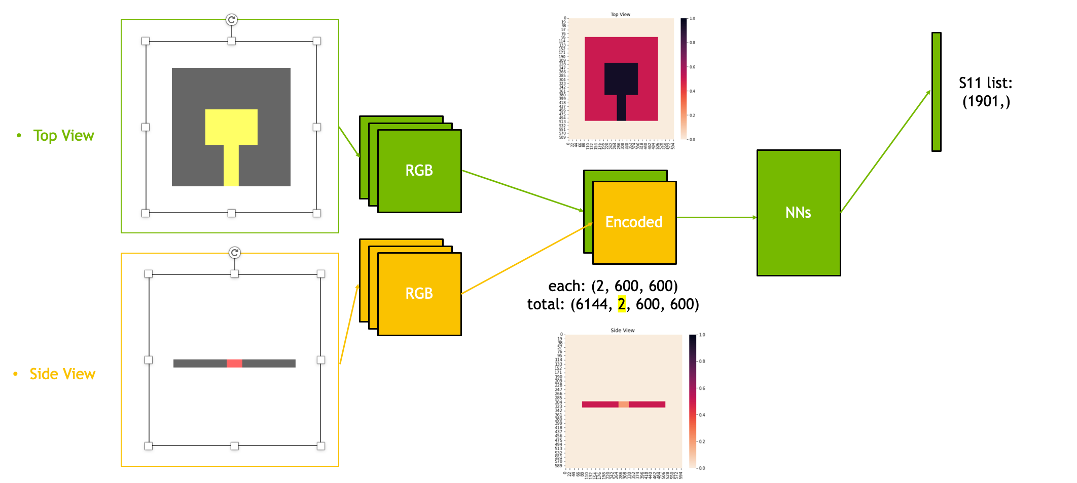
3-D ML Antenna Design

Slide 8
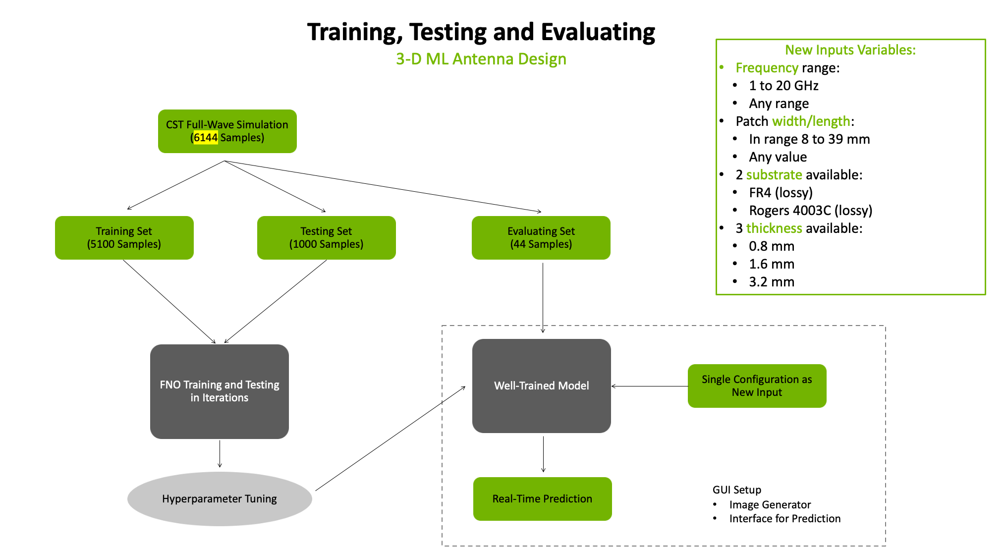
Training, Test and Evaluating

Slide 9
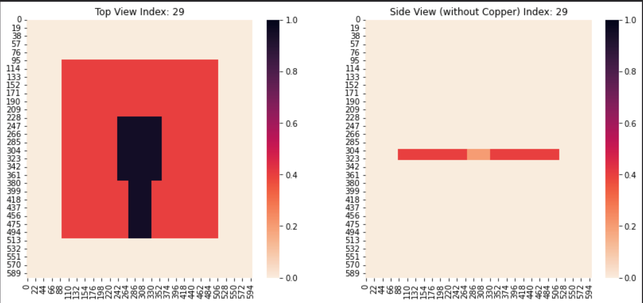
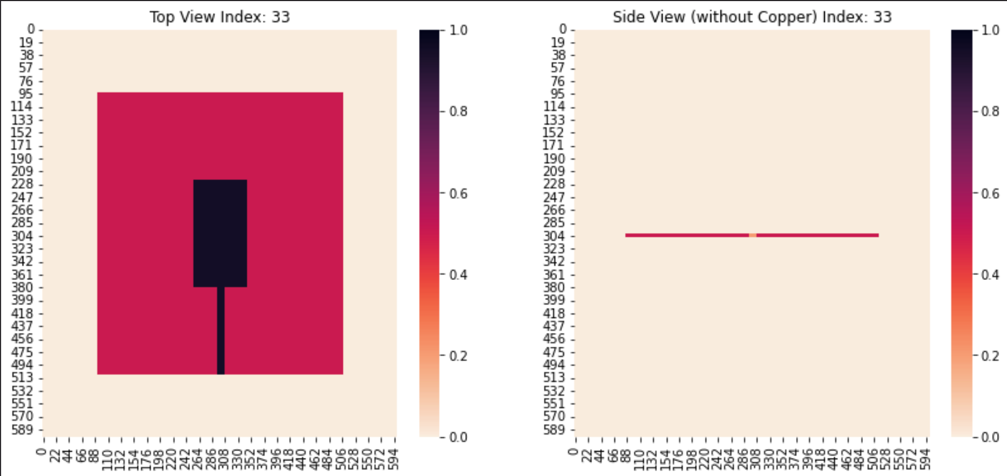
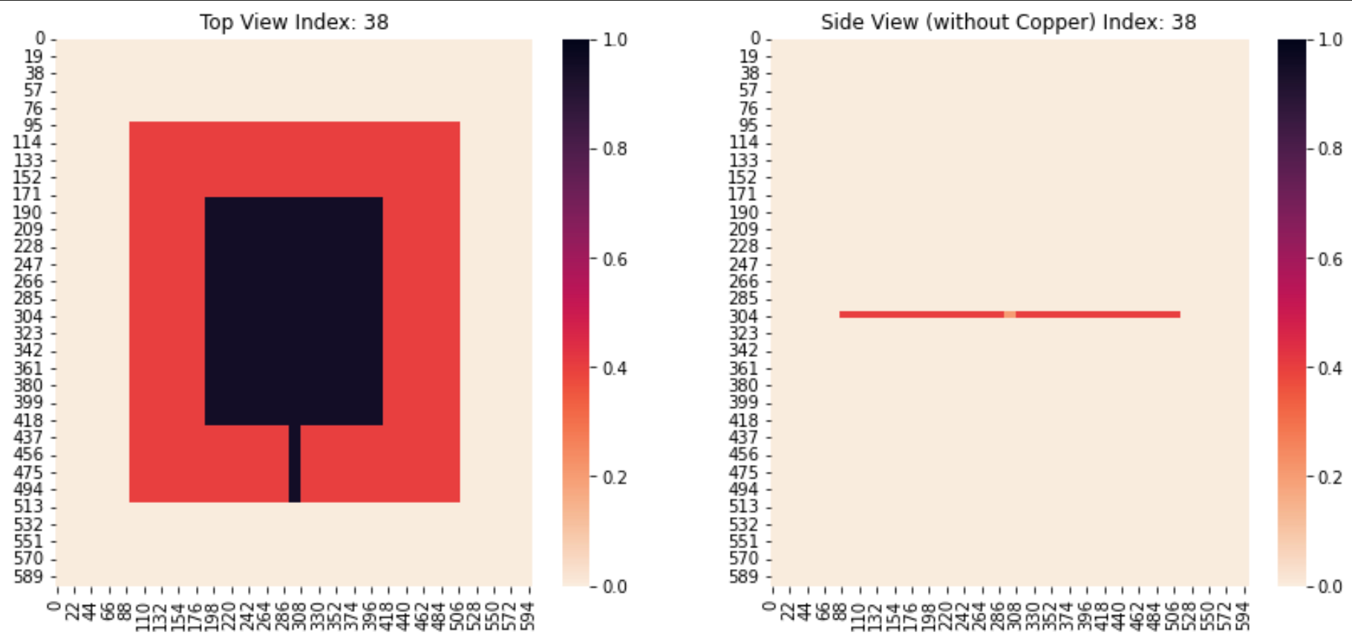
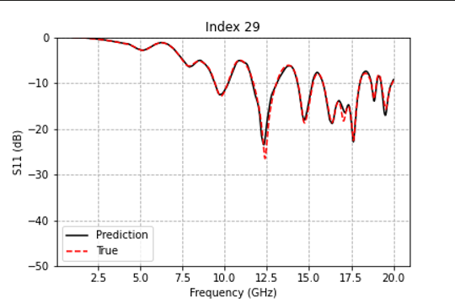
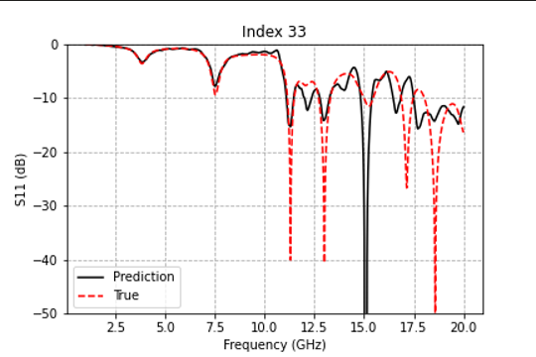
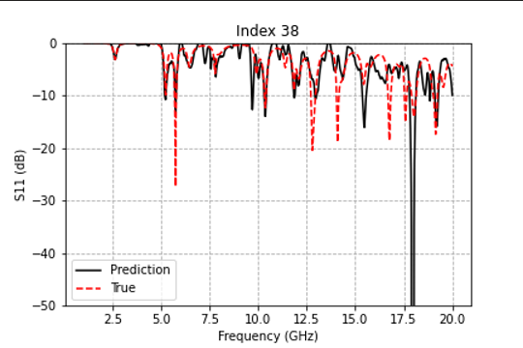
Comparison between Simulation and Prediction
Acceptable Prediction
Prediction out of Range
Not Acceptable Prediction
Suffer from: Fringing Effect

Slide 10
Achieved Cooperation Work
RFID Localization System (Robert and Joseph)
Multi Cylinder Scattering (Rachel)
Human-Tissue related Antenna (Fatih and Rachel)
Chamber Project (Andy)
CP antenna with isotropic properties (Zhen Su)
NF Focusing of transmitarray (Kiris Orcun)
ML based antenna design: Summer Intern 2022
GNSS, LTE and Wi-Fi antenna design: Fall Intern 2022

Slide 11
For further interests, please connect with Yiming and Prof. Elsherbeni for details.

